Slide 1
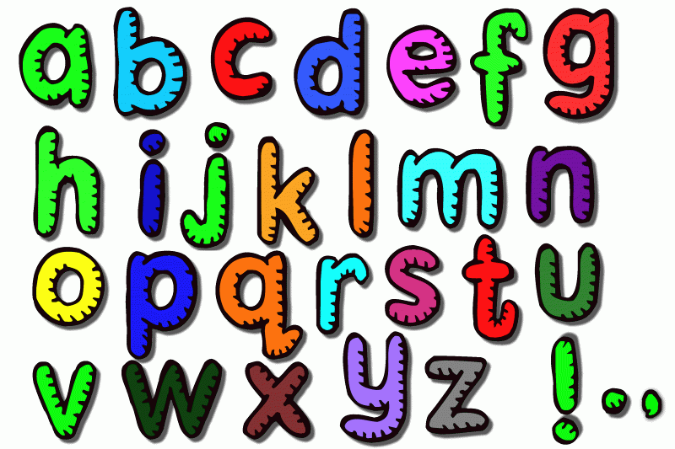
Sampling methods
How many words can you make out of any of the letters of this phrase?

Slide 2
What are the Sampling Methods used in Psychology?
Learning Objectives:
Distinguish between a sample and the target population.
Outline the different types of sampling techniques.
Evaluate the strengths and weaknesses of different sampling techniques.

Slide 3
Big Picture
Why bother?
Takes too long to study everyone
Use a sample of the population to represent everyone
Key word: representative
Population
Sample

Slide 4
In psychological research, it is impossible to study everyone (7 billion +) so the psychologist must try and get a sample that is most representative of their target population.
A target population is the group of people the psychologists want to be able to generalise their findings to.
Population
Sample

Slide 5
Population
In some types of research the target population might be as broad as all humans, but in other types of research the target population might be a smaller group such as teenagers, pre-school children or people who misuse drugs
e.g. if a psychologists wanted to investigate how much TV 16-18yr olds watched, the target population would be all 16-18 year olds who watch TV. The psychologists then needs to take a sample of people who are 16-18year olds to reflect this target population.
Sample

Slide 6
Population
Sampling is the process of selecting participants from the population. The participants in research (the sample) should be as representative as possible of the target population. The more representative the sample, the more confident the researcher can be that the results can be generalised to the target population.
Sample

Slide 7
Population
Often there will most likely be a problem with a psychologist’s sample.
Problems with generalisability may include:
Sample

Slide 8
Population
only studying people from one area
there may be a bias in age (too many old or young)
more men than women may have been used which creates gender bias
or they may only be reflective of one type of ethnic origin.
Sample

Slide 9
Population
These are all issues that psychologists need to take in to consideration when deciding how to select their participants and when analysing their results.
Sample

Slide 10
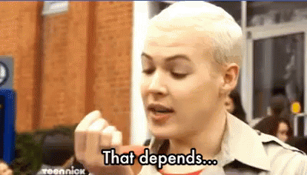
Sample Size
Psychologists try to have as large a sample as possible in order to be able to generalise to the target population confidently. The ideal sample size depends on the size of the target population.

Slide 11
Sample Size
If the sample size is below 50 Ps, it is usually called idiographic. Larger sample sizes are called nomothetic.

Slide 12
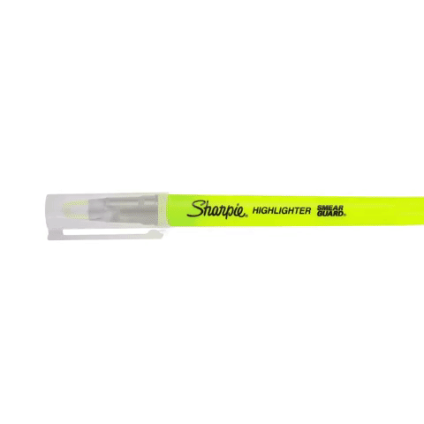
Social | Milgram | 40
 | Bocchiaro | 149
 | Piliavin | 4550
 | Levine | Unknown number from 23 countries
Cognitive | Loftus and Palmer | 45
 | Grant | 39
 | Moray | 28
 | Simons and Chabris | 192
Developmental | Bandura | 72
 | Chaney | 32
 | Kohlberg | 75
 | Lee | 228
Biological | Sperry | 11
 | Casey | 59
 | Blakemore and Cooper | 2 kittens
 | Maguire | 66
Individual Differences | Freud | 1
 | Baron-Cohen | 76
 | Gould | 1.75 million
 | Hancock | 52

Slide 13
Population
Key Terms
Androcentric: biased towards men.
Cultural bias: Sample is too focused on one culture, isn’t representative of all cultures.
Estrocentric: biased towards women.
Ethnocentric: biased towards one culture/ethnicity
Gender bias: Sample is made of people from one gender, it is not representative of all genders.
Idiographic = people are studied as unique entities, each with their own subjective experiences, motivations and values. There may be no attempt made to compare these to a larger group, standard or norm.
Nomothetic = aims to produce general laws of human behaviour. These provide a ‘benchmark’ or reference against which all people can be compared, classified and measured, and so likely future behaviour can be predicted and/or controlled.
Population validity: Can we generalise results from our sample to the target population?
Representative: How well a sample reflects the target population.
Sample: A small set of people taken from the target population.
Target Population: The set of people researchers want to find out about.
Sample
Key Terms

Slide 14
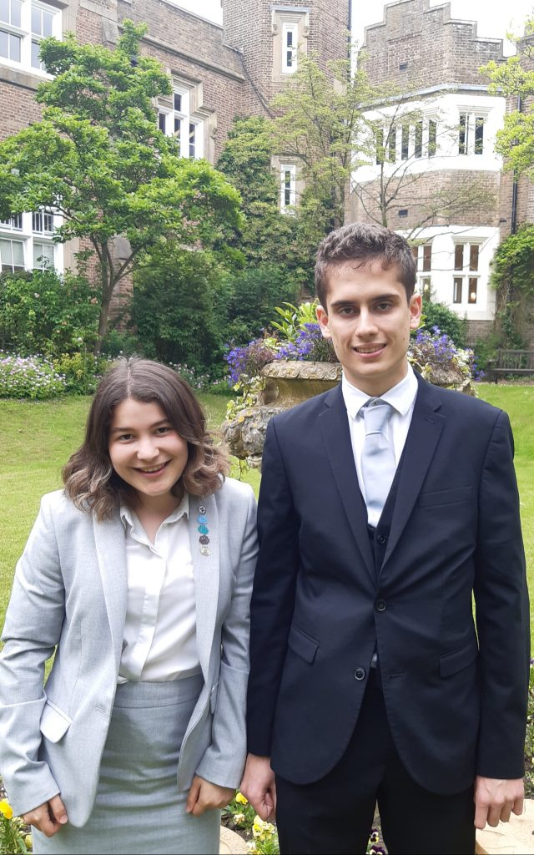
Starter Task – Who will be a representative sample of Aldenham students?

Slide 15
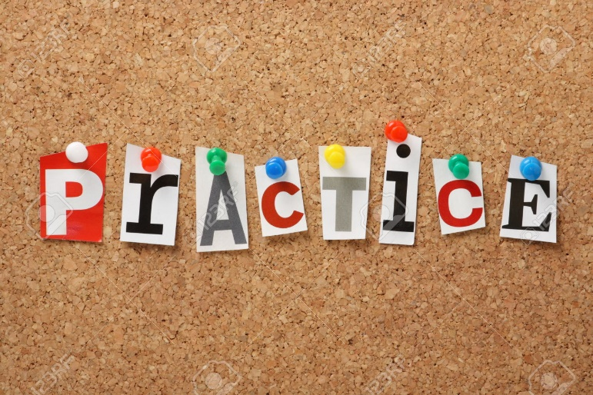
Target Populations and Samples

Slide 16
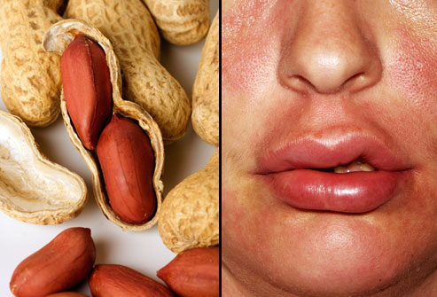
Allergy?

Slide 17
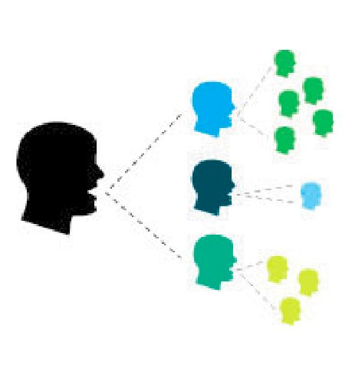
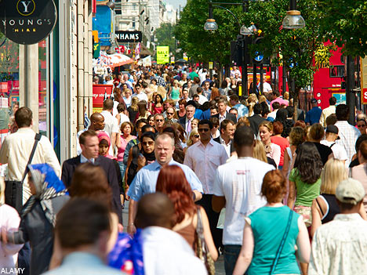
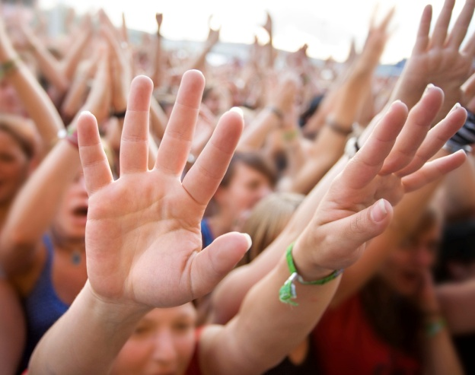
Sampling Methods
Sampling methods
When a psychologist conducts a piece of research they must think of the most suitable way of obtaining the participants, so they are representative of their target population. There are four different types of sampling methods that you need to know with their strengths and weaknesses.

Slide 18
Sampling Methods
Snowball
Random
Self-selecting (Volunteer)
Opportunity

Slide 19
Opportunity Sampling
= Anyone who is available at the time of your research.
e.g. I want to research into the eating habits of men. I walk around the school and survey the first 20 males I find.

Slide 20
Opportunity Sampling
Evaluation
Quick and cheap to carry out, so easy to replicate.
Good for characteristics that we can assume are the same for everyone.
Only sampling method for some research methods (covert field experiment).
But
Sample Bias (researcher might choose helpful looking people).
Still have to ask the participant to take part, which means they could decline.

Slide 21
Self-Selecting / Volunteer Sampling
= Participants choose themselves to take part in the study.
They could be recruited through; using online email surveys, signing up or applying to take part, or responding to adverts or posters.
e.g. Who would fill out an online survey?

Slide 22
Self-Selecting / Volunteer Sampling
Quick and practical to carry out, so easy to replicate.
Can reach a wider variety of participants.
Ethical, as participants have given their consent to taking part.
But
Sample Bias (biased towards the type of person who volunteers for research).

Slide 23
Random Sampling
Every member of the population has a fair and equal chance of taking part.
e.g. Everybody puts their name into a hat, draw first 25 names out of the hat for the sample.
Facebook (2012): Randomly chose 689,000 users and showed either more positive or more negative wall posts.

Slide 24
Random Sampling
Evaluation
The most representative sampling technique to use.
Provides unbiased sample.
But
• Time consuming and often impossible.
• Still have to ask the participant to take part, which means they could decline.

Slide 25
Snowball Sampling
Participants are recruited through being friends/colleagues of existing participants.
e.g. The researcher may know five participants to take part in their research but needs more, so may ask the participants themselves to bring friends of theirs to take part in the research too.

Slide 26
Snowball Sampling
Evaluation
Quick and practical to carry out, so easy to replicate.
Can reach a wider variety of participants.
Ethical, as participants have given their consent to taking part.
But
Sample Bias (probably similar culture as all friends).

Slide 27
Tear out page 9
Re-order the answer in each column
Stick the correct answers onto page 8

Slide 28
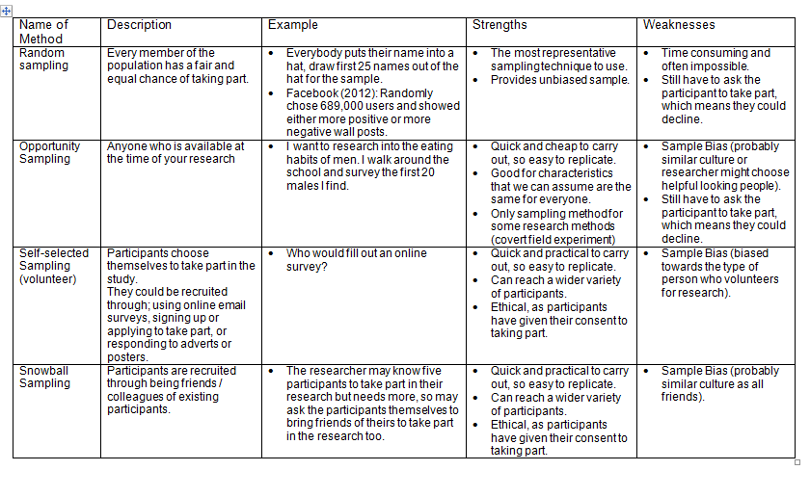
https://quizlet.com/224779183/ocr-psychology-sampling-methods-flash-cards/?new

Slide 29
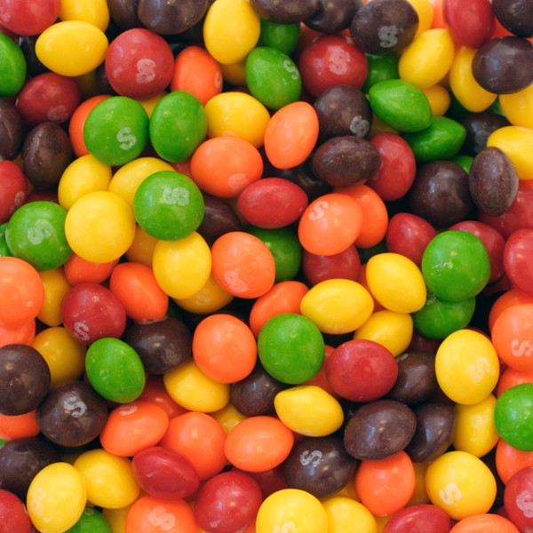
Student Led
Time to practice some sampling (not tasting…yet)
How to do it?
Follow the instructions on the worksheet
You will need a calculator!
Ask if you need help
Colour | Number
Red
Green
Yellow
Orange
Purple

Slide 30
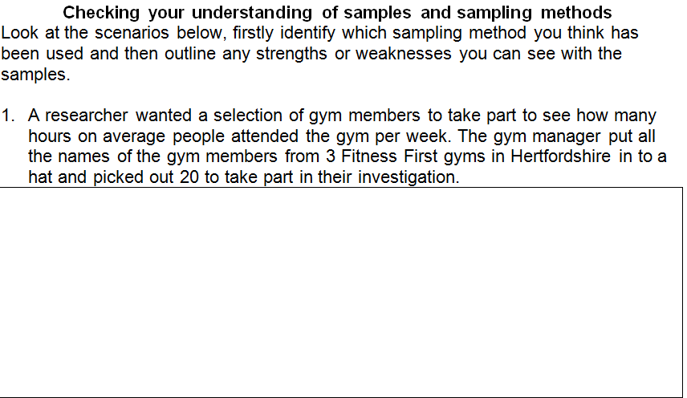
Random
Opportunity
Self-selecting / volunteer
Opportunity
Snowball
Random
https://quizlet.com/224779183/ocr-psychology-sampling-methods-flash-cards/?new

Slide 31
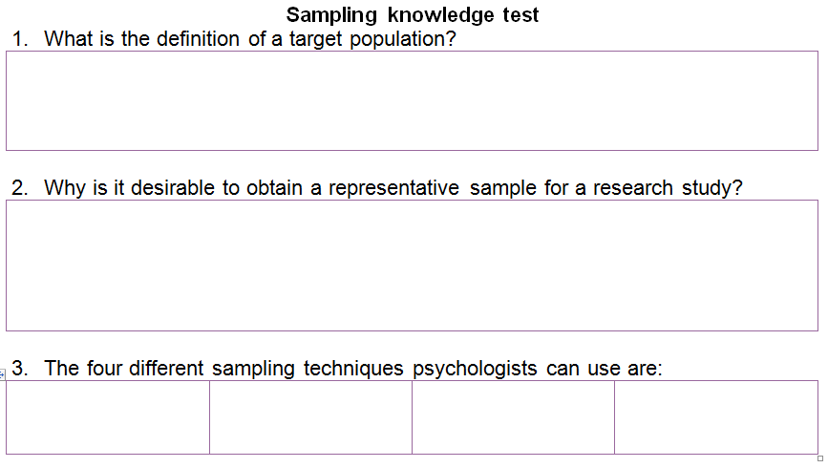
https://quizlet.com/224779183/ocr-psychology-sampling-methods-flash-cards/?new

Slide 32
Timed Test today or tomorrow???

Slide 33
Timed Test – Getting the Best Marks
Question 6 and 8
Point
Explanation – because …
Conclusion – this matters because …
Question 11 and 12
Point
Explanation – because …
Context – unique words from the story
https://quizlet.com/224779183/ocr-psychology-sampling-methods-flash-cards/?new

Slide 34
Timed Test – Getting the Best Marks
Question 6 and 8
Point
Explanation – because …
Conclusion – this matters because …
Question 11 and 12
Point
Explanation – because …
Context – unique words from the story
Peer Marking
Q3: Random , Opportunity, Self-selecting, Snowball
Q5. C
Q9. C
https://quizlet.com/224779183/ocr-psychology-sampling-methods-flash-cards/?new

Slide 35
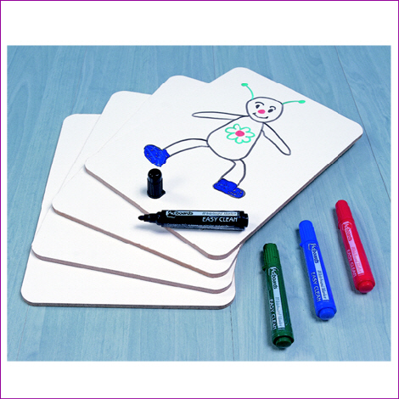
Consolidation
Which type of SAMPLING method?
Which type of RESEARCH method?
Which type of PSYCHOLOGY?
A doctor wishes to question nurses’ attitudes about patient care. Interviewing takes place between 2 and 4pm every Monday for a month.

Slide 36
Consolidation
Which type of SAMPLING method?
Which type of RESEARCH method?
Which type of PSYCHOLOGY?
On Tuesday afternoon next week a study will be taken in Watford to determine whether there are more red or blue cars. A tally will be taken of those driving by a school entrance.

Slide 37
Consolidation
Which type of SAMPLING method?
Which type of RESEARCH method?
Which type of PSYCHOLOGY?
A class chooses a number each between 1 and 49.
The Camelot (National Lottery) machine will be used to select a number.
The winner will receive a prize.

Slide 38
Consolidation
Which type of SAMPLING method?
Which type of RESEARCH method?
Which type of PSYCHOLOGY?
Every hundredth entry in the phone book will be contacted to take part in the study.

Slide 39
Consolidation
Which type of SAMPLING method?
Which type of RESEARCH method?
Which type of PSYCHOLOGY?
Every child born on 26th September 2015 will be weighed.
Their weight will then be tracked every year for the next five years.

Slide 40
Consolidation
Which type of SAMPLING method?
Which type of RESEARCH method?
Which type of PSYCHOLOGY?
All attendees of the Glastonbury festival will be asked to complete a survey on security.

Slide 41
Consolidation
Which type of SAMPLING method?
Which type of RESEARCH method?
Which type of PSYCHOLOGY?
A lady on the street stops you to ask whether you have home insurance.

Slide 42
Consolidation
Which type of SAMPLING method?
Which type of RESEARCH method?
Which type of PSYCHOLOGY?
The teacher places our names into a hat and picks one person to answer a question.

Slide 43
Consolidation
Which type of SAMPLING method?
Which type of RESEARCH method?
Which type of PSYCHOLOGY?
Everybody with a surname beginning with Z, please stand up.

