Slide 1
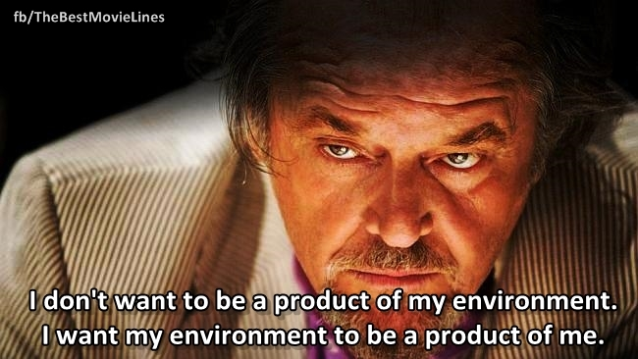
Do you think your environment can influence your brain structure?

Slide 2
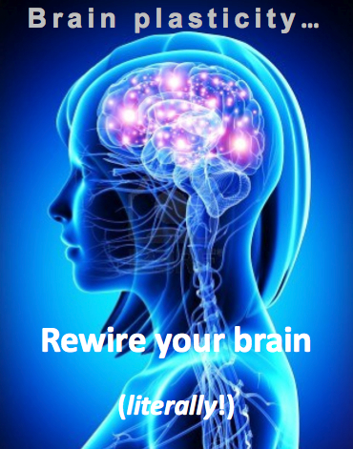
Do you think your environment can influence your brain structure?

Slide 3
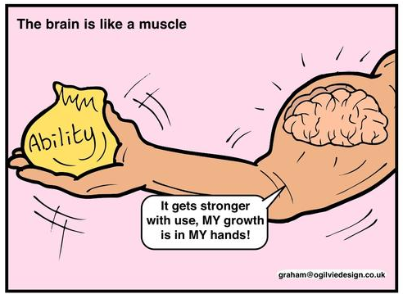
Really?????
https://www.youtube.com/watch?v=ELpfYCZa87g
https://www.youtube.com/watch?v=f2fCY_M7Vms

Slide 4
Blakemore and Cooper (1970) Development of the brain depends on the visual environment
Learning Objectives
To understand the procedure of Blakemore and Cooper’s study
To evaluate the study
To consider whether the environment can influence brain structure
https://www.youtube.com/watch?v=QzkMo45pcUo

Slide 5
Blakemore and Cooper (1970) Development of the brain depends on the visual environment
As we watch the 2 videos,
1. start to summarise your notes into:
Aim
Sample
Procedure
Results
Conclusions
2. Identify words unique to the study which you can use to show context (e.g. minocular / binocular / perpendicular)
https://www.youtube.com/watch?v=QzkMo45pcUo
https://www.youtube.com/watch?v=jPIWKoqUWow

Slide 6
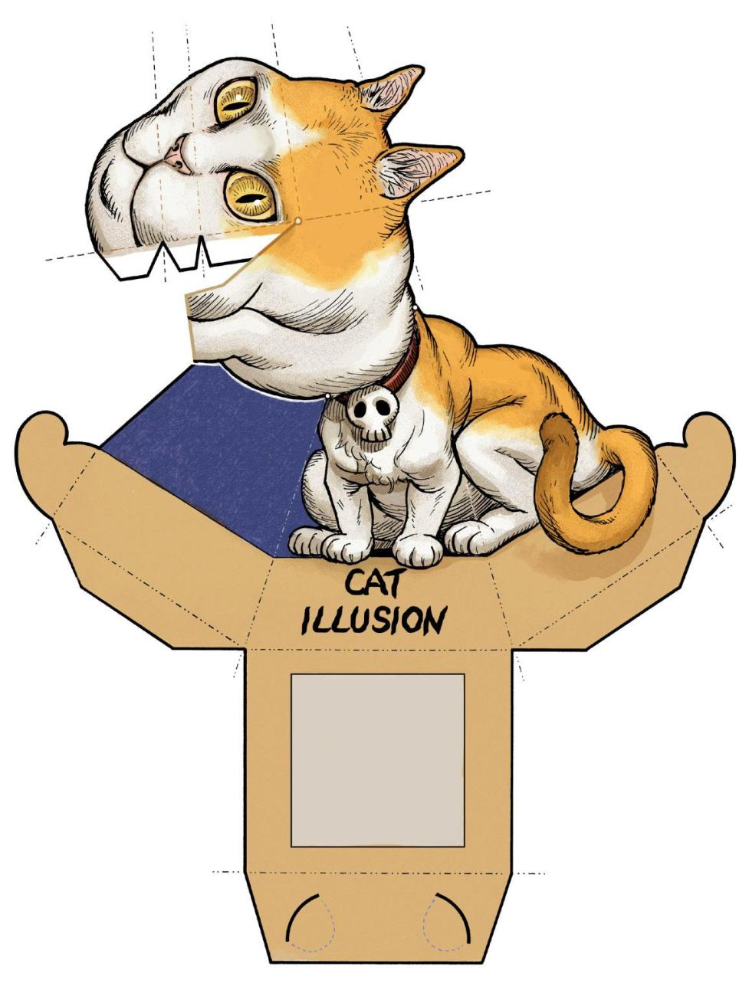
Model Activity
Make a model of the equipment used
You need to make a model of a cat (with a restrictive collar).
Design the collar.
Design the cylinder with horizontal or vertical lines

Slide 7
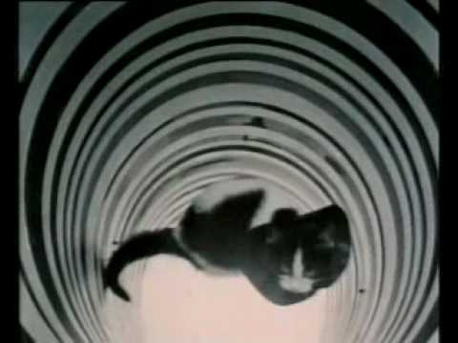
Aims
The aim of this study was to study cats who had limited visual experience.
The kittens were limited to one visual orientation – either vertical stripes or horizontal stripes.
The cats’ behaviour was then observed to see the effects of limiting their visual experience.

Slide 8
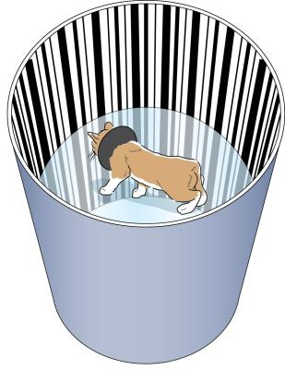
Method
From birth, the kittens were housed in a completely dark room and then from the age of two weeks the visual experience of the kittens was manipulated.
They were placed in either a completely vertically-oriented or a completely horizontally-oriented environment.

Slide 9
Method
This was achieved by placing the kitten in a specially designed cylindrical piece of apparatus in which there was a clear glass platform halfway up the cylinder on which the kitten was placed. The cylinder was 46 cm in diameter and about 2 metres high.

Slide 10
Method
The inside of the cylinder, as far up and down as the kitten could see, was decorated either with vertical high contrast black and white stripes or with horizontal high contrast black and white stripes. The stripes were of a variety of widths.
The kittens spent about 5 hours a day in this apparatus. They wore a wide black collar so that they could not see their own bodies, and this limited their vision to about 130 degrees. A top cover was placed on the cylinder.

Slide 11
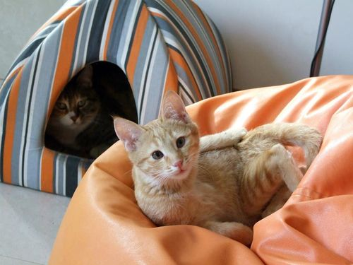
Five months later…
The kittens stopped being placed into the cylinder after 5 months.
The kittens were then taken for several hours each week to a well-lit room, furnished with chairs and tables.
The psychologists monitored the cats’ reactions.

Slide 12
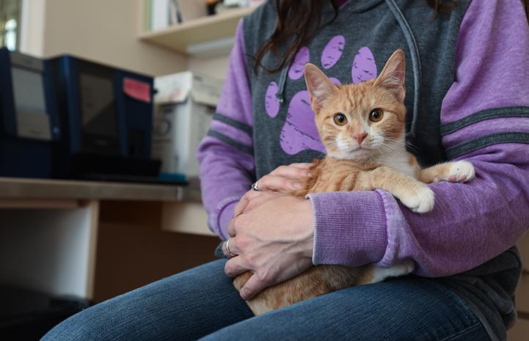
Results
At first both groups (horizontal and vertical) were extremely visually inept.
They exhibited no startle response (the defensive action taken by your body when surprised) when an object was thrust towards them.
They guided themselves by touch and became frightened when they reached the edge of the surface they were standing on.

Slide 13
Results
These deficiencies started to disappear after around 10 hours.
The startle response and visual placing returned.
The cats began to jump from the chair to the floor.
However, some problems were permanent…

Slide 14
Permanent deficiencies
The cats followed objects with clumsy, jerky head movements and they tried to touch things that were well beyond their reach (such as items on the other side of the room).
The cats actively explored the room but they often bumped into the table legs as they scurried around.

Slide 15
Horizontal vs. vertical
The cats were virtually blind to contours perpendicular to the orientation they had experienced (cats that saw only horizontal stripes were blind to vertical contours, and cats that experienced vertical stripes were blind to horizontal stripes).

Slide 16
Horizontal vs. vertical
A sheet of Perspex with thick black and white lines was presented to the kittens. They showed no reaction if it was presented to them in the ‘wrong’ orientation, but would respond to the ‘right’ orientation with a startle response.

Slide 17
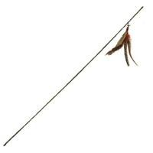
Horizontal vs. vertical
A rod was shaken in front of the kittens.
If the rod was shaken in the correct orientation for the cat, then the cat would react, but a cat that had experienced the opposite orientation, they would ignore it.

Slide 18
Neurophysiological results
Two cats (7.5 months old) were anaesthetised and their neurons were investigated.
A normal cat would have neurons around the clock, i.e. both vertical and horizontal.
Horizontally raised kitten there were no neurons in the vertical orientation
Vertically raised kitten there were no neurons in the horizontal orientation.

Slide 19
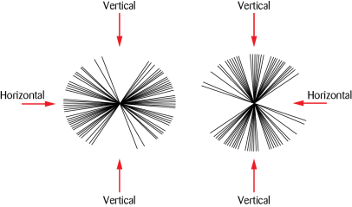

Slide 20
Conclusions
Brain development is affected by early experiences and environmental factors rather than just genetics
There is clear evidence of brain plasticity – the visual experience of the kittens modified their brains and specifically their visual neurons
The kittens’ visual cortex adjusts during development as a result of its visual experiences.
The study lends evidence to the nurture side of the debate.
https://quizlet.com/265410145/blakemore-and-cooper-outline-and-evaluation-flash-cards/

Slide 21
HOW is the data collected in?
There is a difference to WHAT the research method is and HOW the data is collected in.
https://quizlet.com/265410145/blakemore-and-cooper-outline-and-evaluation-flash-cards/

Slide 22
HOW is the data collected in?
There is a difference to WHAT the research method is and HOW the data is collected in.
https://quizlet.com/265410145/blakemore-and-cooper-outline-and-evaluation-flash-cards/

Slide 23
HOW is the data collected in?
Casey
Maguire
Hancock
Baron-Cohen
Piliavin
Levine
Blakemore and Cooper
Milgram
Bandura
Sperry
Kohlberg
Simons and Chabris
Grant
Loftus and Palmer
Gould
Bocchiaro
Moray
Freud
Lee
Chaney
https://quizlet.com/265410145/blakemore-and-cooper-outline-and-evaluation-flash-cards/

Slide 24
Evaluation
https://play.kahoot.it/#/?quizId=5bf71697-b523-4a4d-8ed0-5dcf4149efa2

Slide 25
Evaluation
What are the features of a lab experiment?
IV, DV, controlled environment.
What was the independent variable?
Direction of stripes- horizontal & vertical
What was the dependant variable?
The behaviour and orientation of neurons in the cats’ brain.

Slide 26
Evaluation
What was controlled?
The size and shape of the visual apparatus,
what the kitten could see other than the visual apparatus,
the time of exposure to the visual apparatus

Slide 27
Evaluation
What is the advantage of a lab experiment compared to other experimental methods?
You can see cause and effect.
The only difference in the experience of the kittens was the direction of the lines they could see, so it must have been the cause of the differences in the kittens’ behaviour (e.g. response to vertical/horizontal rods) and orientation of neurones.

Slide 28
Evaluation
What is the main weakness of a lab experiment?
Lack of ecological validity
Are these weaknesses apparent in Blakemore and Cooper’s study?
Debatable, as such extreme deprivation doesn’t happen regularly.
However, the extreme conditions clearly affected the cats’ brains and other visual deprivations would presumably also affect human brains.
So perhaps low ecological validity is less an issue when studying the impact of the environment on our biology than it would be on other psychological areas.

Slide 29
Evaluation
What is quantitative data?
Data which measures quantities of something, usually in numbers
What are the advantages of quantitative data?
It allows information to be presented and compared easily, perhaps in the form of graphs. It also allows for inferential tests to be undertaken checking the likelihood that the results were obtained by chance.
What quantitative data did Blakemore and Cooper collect?
The number of neurons that responded to presentation in a particular orientation.

Slide 30
Evaluation
How likely is this result to have occurred by chance?
Less than once in one hundred thousand.
What are the disadvantages of quantitative data?
It tends to be superficial (as opposed to in depth) which reduces the amount of true understanding of the issue we can gather.
The number of neurones which respond to a particular orientation does not tell us how the cat’s behaviour or understandings of the world were influenced.

Slide 31
Evaluation
What is qualitative data?
Data which attempts to measure the qualities of something, usually in the form of words.
What are the advantages of qualitative data?
It allows us to get in depth, rich information which should give us a full understanding of an issue.

Slide 32
Evaluation
Give an example of qualitative data Blakemore and Cooper presented in their study.
E.g. cats would not have a ‘startle’ response to a particular orientation of lines, that they seemed frightened when on the edge of a surface
Blackmore and Cooper gathered both types of data. What were the advantages of this?
The qualitative data helps us to understand how the cat was really affected in its ability to experience the world whereas the quantitative data was objectively measured, not influenced by opinion or bias, and could be represented graphically with a statistical test performed on it.

Slide 33
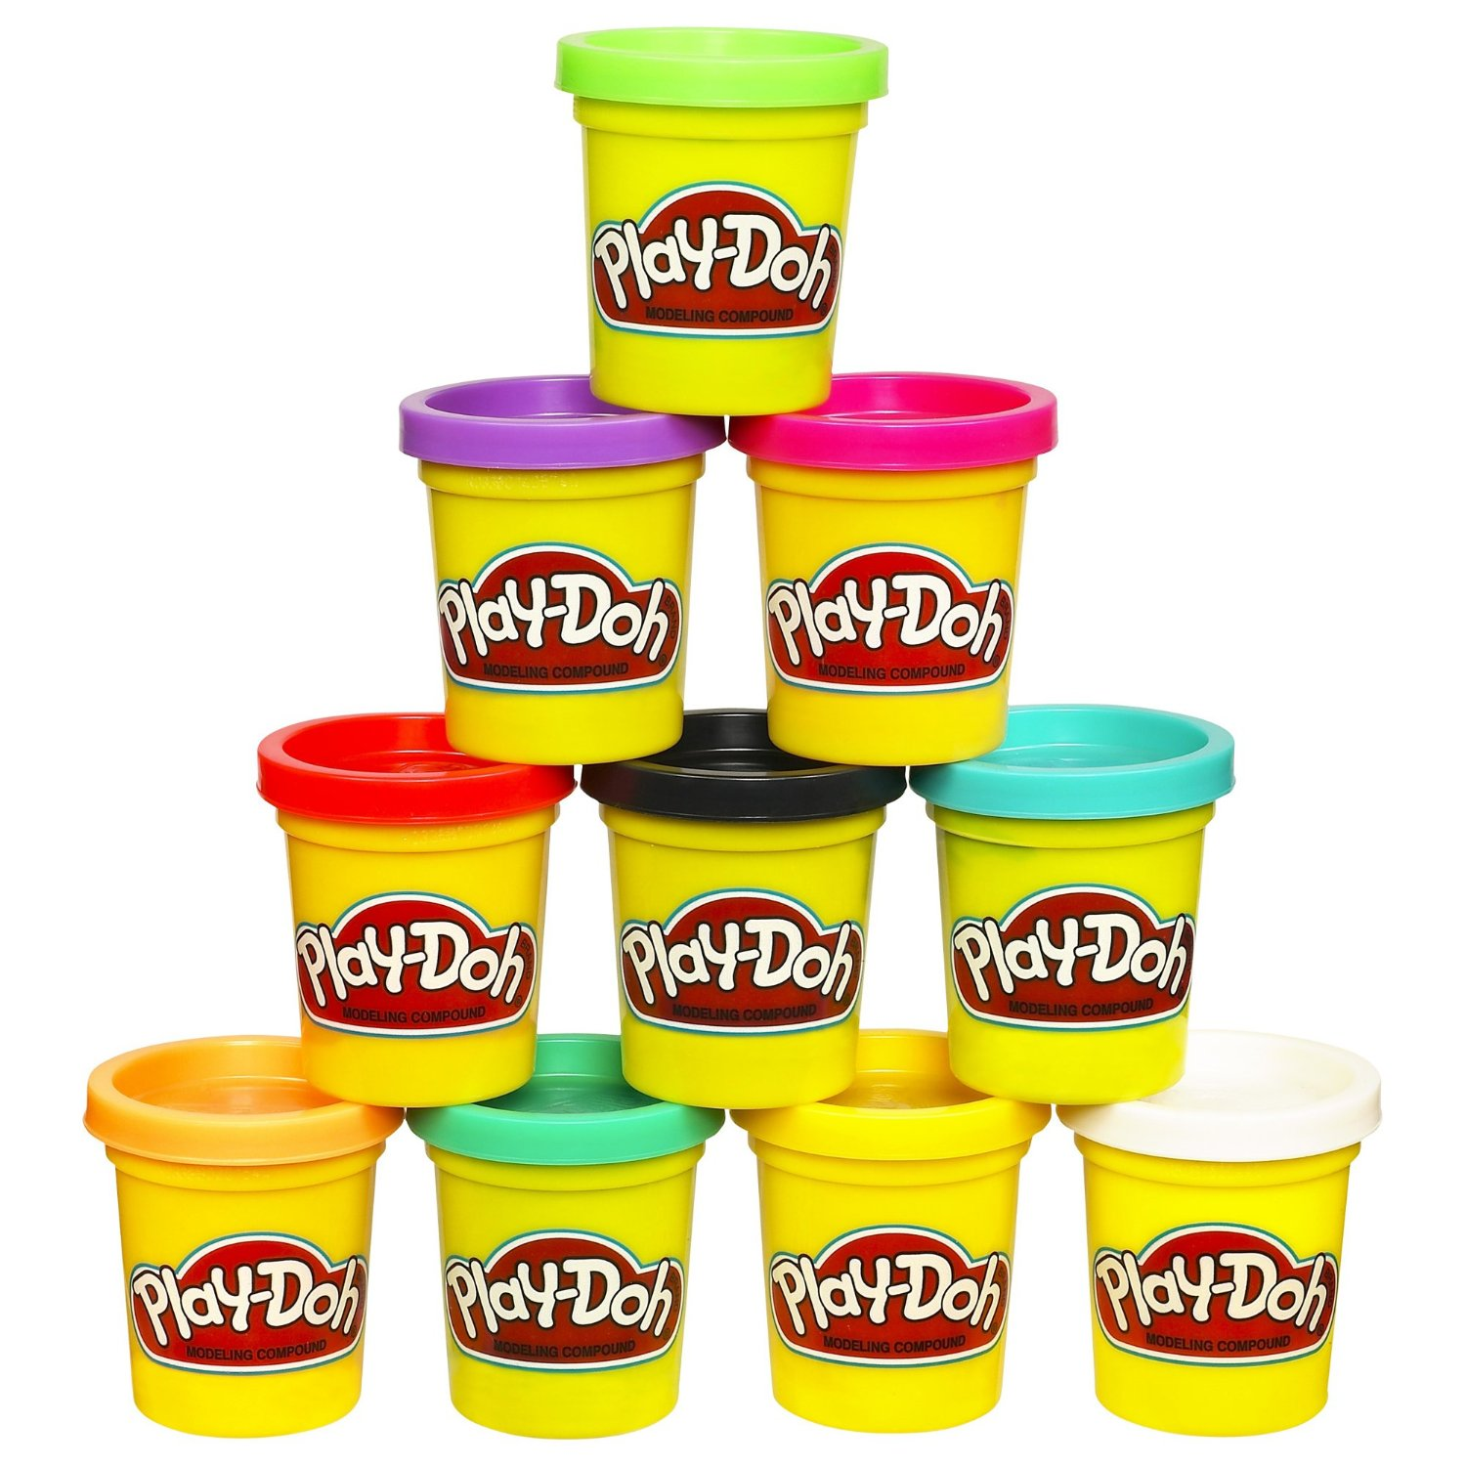
Tactile Task
Show the equipment used in Blakemore and Cooper’s study in PlayDoh

Slide 34
Tactile Task
Show the equipment used in Sperry’s study in PlayDoh

Slide 35
Tactile Task
Show the equipment used in Milgram’s study in PlayDoh

Slide 36
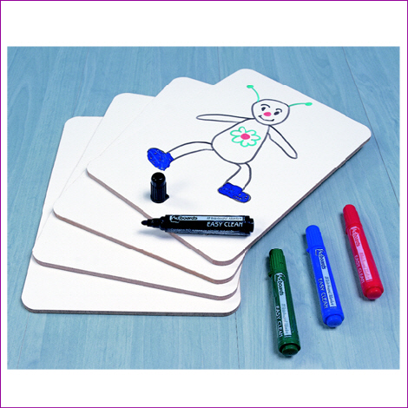
On your whiteboard
Name a study which shows the nature side of the nature – nurture debate
What is a weakness of taking this side?
Name a study which shows the nurture side of the nature – nurture debate
What is a weakness of taking this side?
Name a study which shows an interactionist approach

Slide 37
On your whiteboard
Name 4 features of a science
Name an AREA / PERSPECTIVE which shows that Psychology IS a science?
Name a study which shows that Psychology IS NOT a science

Slide 38
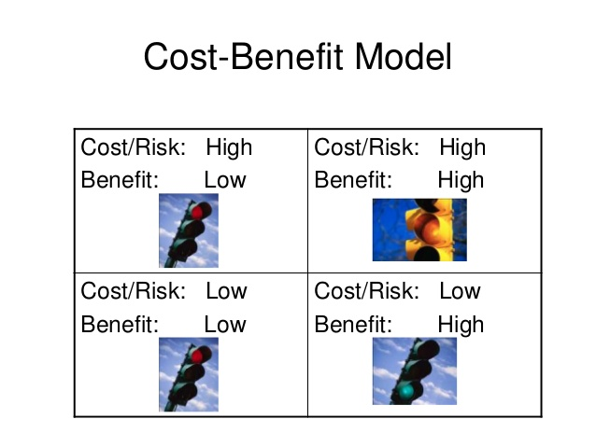
Ethics
The key guidelines are:
use as few animals as possible;
inflict as little pain or distress as possible;
only use animals when alternatives (e.g. tissue samples) could not be used;
use a species as undeveloped and less likely to suffer as possible (e.g. don’t use a mouse where you could use a locust.)

Slide 39
Ethics
The key guidelines are:
use as few animals as possible;
inflict as little pain or distress as possible;
only use animals when alternatives (e.g. tissue samples) could not be used;
use a species as undeveloped and less likely to suffer as possible (e.g. don’t use a mouse where you could use a locust.)

Slide 40
Evaluation

Slide 41
Evaluation
Did Blakemore and Cooper use as few animals as possible?
Yes, at least in their measuring of the individual’s neurone responses which was an invasive procedure, only one kitten from each condition was used.
Where there alternatives to using animals at all?
Not if the study was to be done.

Slide 42
Evaluation
Was the species as ‘low’ as possible & less likely to suffer?
Kittens are less likely to suffer than primates, so that’s a good thing
A mammal really needed to be used in this study for it to be generalisable.
Would a mouse have done as well - possibly, but perhaps its brain is too different to humans to be sure to generalise from it.

Slide 43
Evaluation
In what ways are cat brains and eyes similar to human ones? How do they differ?
Eyes are binocular and see in colour. Both species see clearly.
Brains both have a visual cortex which is located in similar places.
Cat brains are smaller and less capable of organised thought.

Slide 44
Evaluation
So can we generalise the data from Blackmore and Cooper and apply to humans?
The physiological differences between the cat’s brain and a human brain plus the young age of the kittens would make the data difficult to generalise, despite the minor similarities. In addition, the lack of ecological validity prevents the data being generalised to everyday situations.

Slide 45
Evaluation
What is validity?
the accuracy of a test’s ability to measure what it is supposed to measure.
To what extent were the kittens’ experiences similar to those which are experienced by humans?
Probably because other extraneous variables e.g. the time of the exposure to the lines, or the kittens seeing their own bodies, were controlled so we can be confident that they didn’t influence the kittens’ development and the only thing which did was the lines they saw. Therefore the conclusion is valid.

Slide 46
Evaluation
What can be concluded about the validity of Blakemore and Cooper’s study?
It is not totally valid. But some visual impairments e.g. extreme astigmatism may reduce human ability to perceive the world and brain development in this case may be similarly affected. So perhaps the study has some ecological validity.

Slide 47
Evaluation: Reliability
What does a study need to be reliable?
It needs to be replicated to achieve the same results. This requires a standardised procedure which could be repeated and have the same effect on the next sample.

Slide 48
Evaluation: Reliability
Was Blakemore and Cooper’s procedure replicable? Give an example of something they did which could be repeated.
E.g. keeping the kittens in the exact same size visual display apparatus.

Slide 49
Evaluation: Reliability
With the high levels of control is it likely that the study, if repeated, would have the same results? What can we conclude here about the reliability of the study?
Yes. It was reliable and consistency of results suggests reliability.

Slide 50
Evaluation: Sample
What was Blakemore and Coopers’ sample?
The sample in the study consisted of two kittens who were housed from birth in a completely dark room.
Is there anything different to the sample here and the target population?
We can’t say if the kittens were different to every day kittens, but they were bred for research so perhaps they came from a breed strain different to the average kitten?

Slide 51
Evaluation: Sample
As there were only two kittens that were used in the study, is it possible that there was something unusual about those kittens?
Yes. But it is unlikely.
Are the results of this study more applicable to one ethnic group than another? Why or why not?
No - our brain biology is consistent across cultures and ethnicities.
So is this study ethnocentric? No

Slide 52
Which study would link to the issue/debate?
Nature / nurture debate
Freewill / Determinism
Reductionism / Holism
Individual / Situational Explanations
Usefulness
Ethics
Conducting Socially Sensitive Research
Psychology as a Science

Slide 53
Links to debates
The study suggests that the environment that cats live in has a big impact on their visual system. Does this support the nature or the nurture side of the debate?
Like many studies that come under the biological area, this study is controlled, replicable and falsifiable. What debate does this relate to?

Slide 54
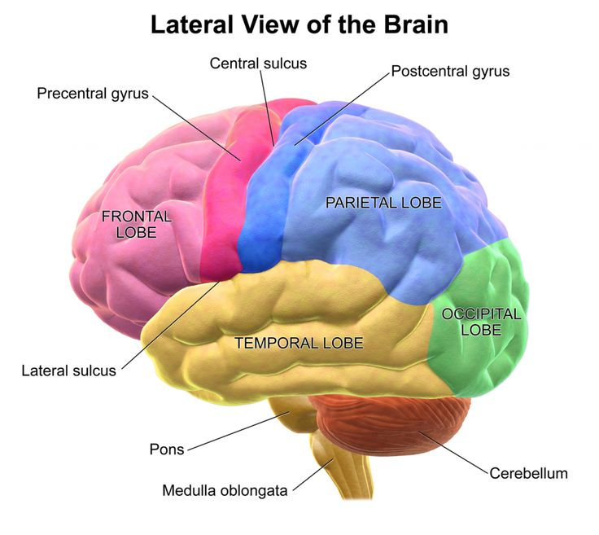
Links to areas/perspectives
Blakemore and Cooper’s study comes under the biological area as it is investigating the effect of the environment on the developing brain in cats.
The study investigates brain plasticity in cats and how the environment can alter the preferred orientation of neurons.

Slide 55
Links to areas/perspectives
Why would the study be placed in this area?
What characteristics of the study show the principles of the area?
Use at least 1 # of the area
Explain the aim / conclusion of the study which links with the #
Detail about the study
https://quizlet.com/265410145/blakemore-and-cooper-outline-and-evaluation-flash-cards/

Slide 56
Links to areas/perspectives
Blakemore and Cooper’s study comes under the biological area as it is investigating the effect of the environment on the developing brain in cats.
The study investigates brain plasticity in cats and how the environment can alter the preferred orientation of neurons.
https://quizlet.com/265410145/blakemore-and-cooper-outline-and-evaluation-flash-cards/

Slide 57
Links to key themes
Key theme = brain plasticity.
Blakemore and Cooper’s study found that in the developing brains of cats the visual neurons will change their preferred orientation depending on the environment that the cat is raised in (vertical or horizontal stripes).
This shows that cats’ brains are able to adapt, i.e. have plasticity.

